Slide 1

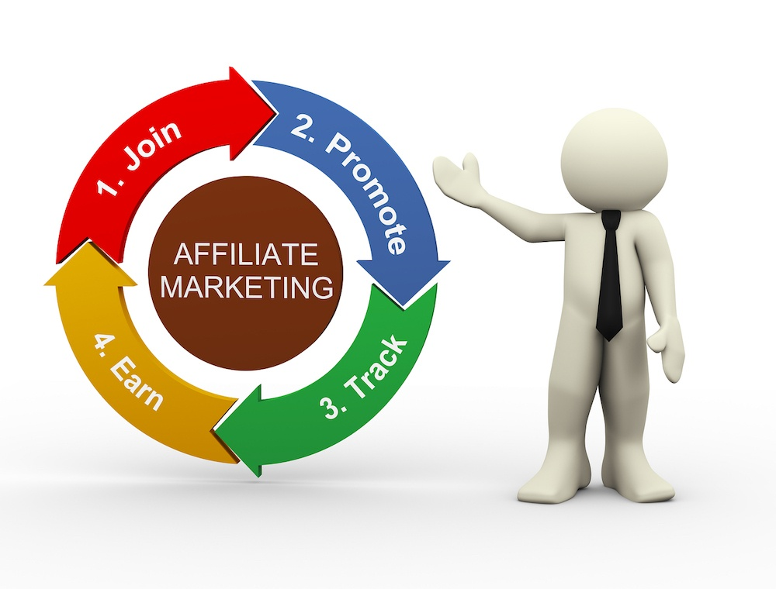
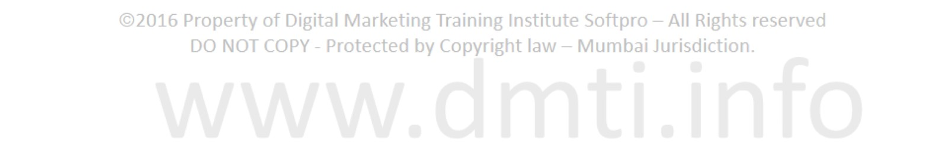

Affiliate Marketing
www.dmti.mobi | www.dmti.co.in

Slide 2
What Is Affiliate Marketing ?
Affiliate marketing is the process of earning a commission by promoting other people’s (or company’s) products.
You find a product you like, promote it to others and earn a piece of the profit for each sale that you make.
www.dmti.mobi | www.dmti.co.in

Slide 3
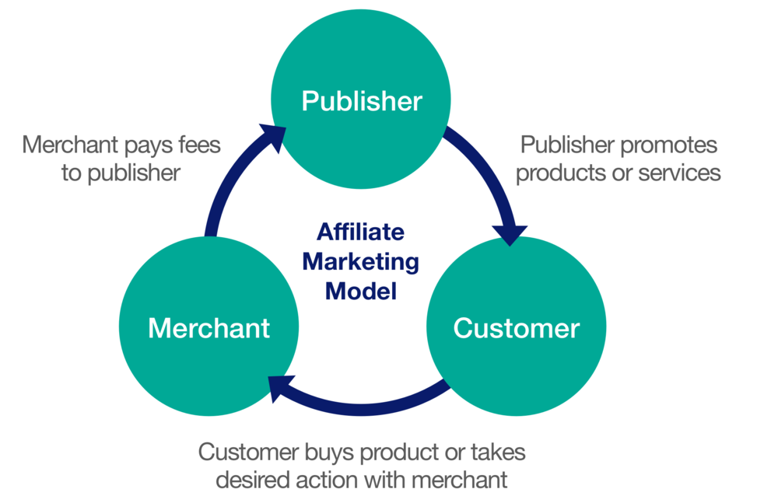
Key Players
www.dmti.mobi | www.dmti.co.in

Slide 4
Key Players
MERCHANT
Merchant creates the product. It can be a big company Or, it can be a single individual
From solo entrepreneurs to startups companies, anyone could be the merchant behind an affiliate marketing program. They just have to have a product to sell.
www.dmti.mobi | www.dmti.co.in

Slide 5
Key Players
PUBLISHER
An Affiliate marketing publisher is an individual website owner or business entity that earns commissions for referring sales, leads, and traffic to an advertiser by placing affiliate marketing advertisements such as links and banners on their websites.
www.dmti.mobi | www.dmti.co.in

Slide 6
Key Players
CONSUMER
The consumer Or Customer makes the affiliate system go round. Without sales, there aren’t any commissions to hand out and no revenue to be shared.
The affiliate will try to market to the consumer on whatever channel they see fit, whether that’s a social network, banners or through a search engine using content marketing on a blog.
.
www.dmti.mobi | www.dmti.co.in

Slide 7
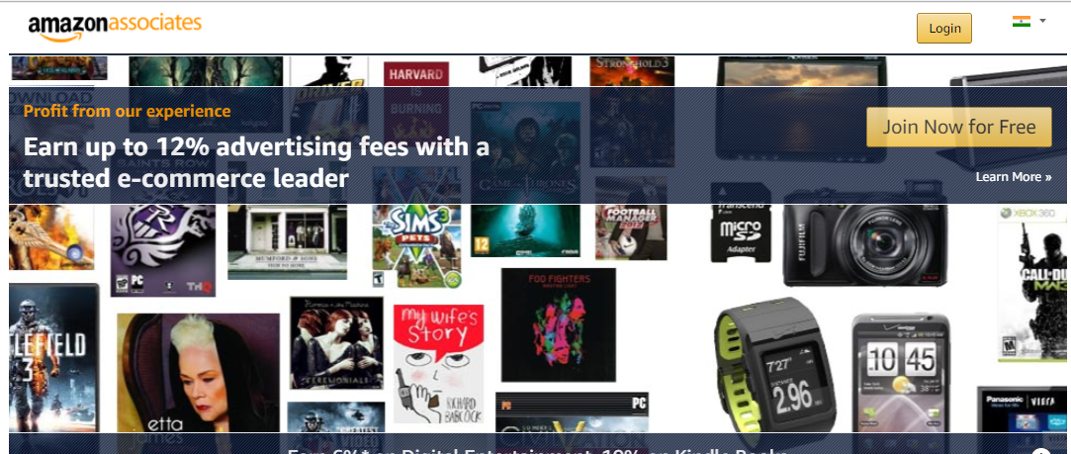
Amazon Affiliate Program
www.dmti.mobi | www.dmti.co.in

Slide 8
Introduction
Amazon is one of the world’s biggest marketplaces. Even though there are so many affiliate marketplaces in the world, many bloggers, and big companies use Amazon to sell their products.
Their affiliate program pays you up to 15% of the sale amount and, depending on what kind of sale you are making, it’s a good way to make big
www.dmti.mobi | www.dmti.co.in

Slide 9
How To Join
1) Go to Amazon Affiliate Website
2) Click On Join Now For Free
www.dmti.mobi | www.dmti.co.in

Slide 10
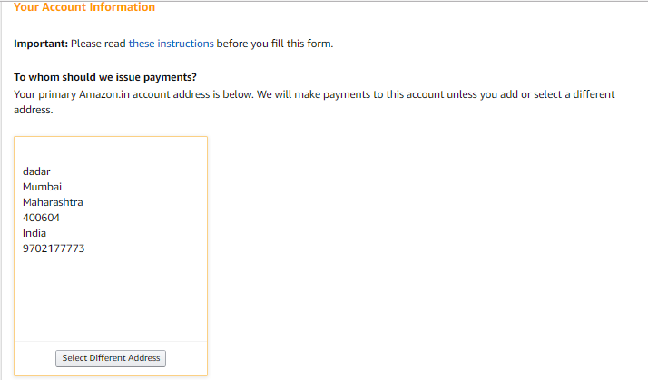
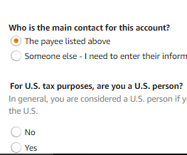
How To Join
3) Confirm The Details
www.dmti.mobi | www.dmti.co.in

Slide 11
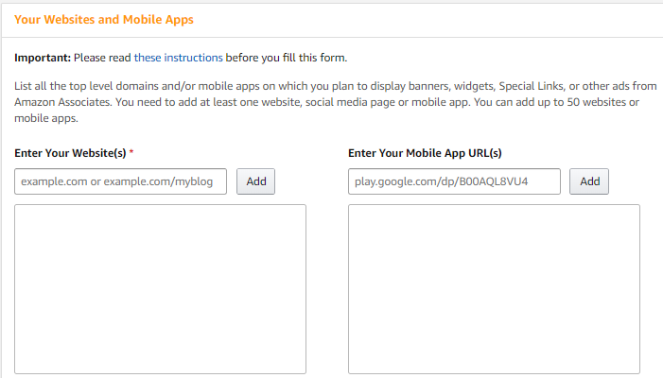
How To Join
4) Enter Your Webiste Details
www.dmti.mobi | www.dmti.co.in

Slide 12
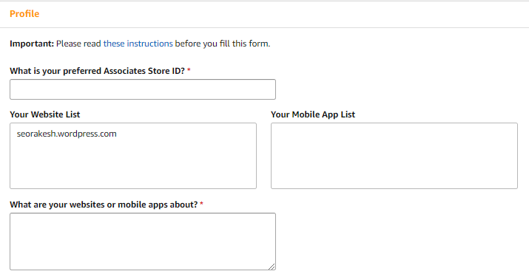
How To Join
5) Enter Your Profile Details
www.dmti.mobi | www.dmti.co.in

Slide 13
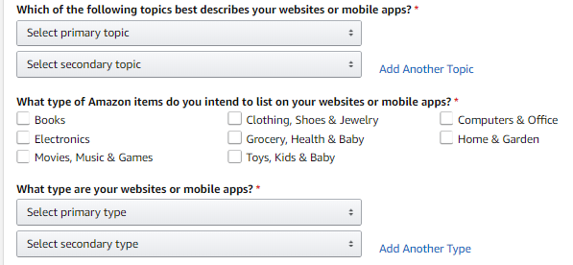
How To Join
5) Enter Your Profile Details
www.dmti.mobi | www.dmti.co.in

Slide 14
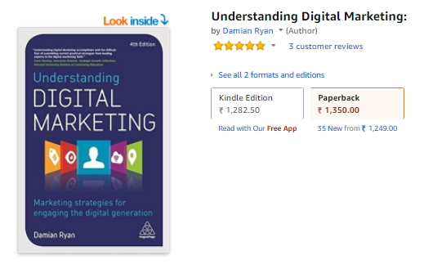
How To Get Affiliate Link
1) Go To Amazon.in With
Affiliate Login.
2) Select product You Want
to Promote.
www.dmti.mobi | www.dmti.co.in

Slide 15
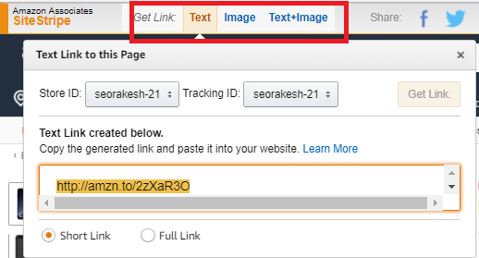
How To Get Affiliate Link
3) Click on Text to get the Affiliate Link
www.dmti.mobi | www.dmti.co.in

Slide 16
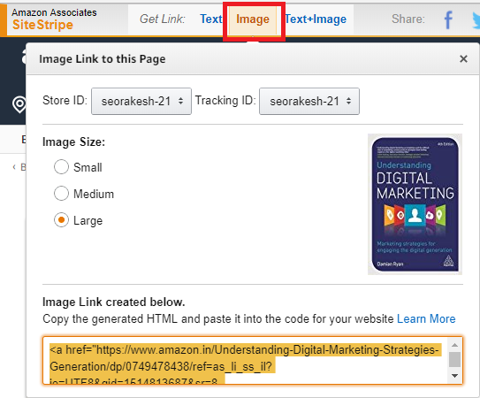
How To Get Affiliate Link
3) Click on Image
to get the Image Code
www.dmti.mobi | www.dmti.co.in

Slide 17
How To Promote Link
1) Write A Review Of The Product & Update it In Your Blog. Enter The Affiliate Link
2) Add Image Banner On Your Website
3) Promote The Link On Youtube and Other Media
www.dmti.mobi | www.dmti.co.in

Slide 18
Key Points
1. Pick Product Based On Your Niche
2. Focus on Keywords that People Actually Search For
3. Be Honest with Your Audience
4. Make Your Content Worth Reading
5. Assess Your Results Frequently
www.dmti.mobi | www.dmti.co.in

Slide 19
Key Points
1. Pick Product Based On Your Niche
Let’s say your blog focuses on emerging portable technologies, such as smart phones and tablet PCs. Selecting affiliate marketing programs offered by wireless internet providers would make an excellent fit.
www.dmti.mobi | www.dmti.co.in

Slide 20
Key Points
2. Focus on Keywords that People Actually Search For
Let’s say your niche is streaming media services. People love lists, reviews and comparisons, so keyword phases like “Top 5 Online Video Services. “Best Online Video Services etc. would all be excellent options.
www.dmti.mobi | www.dmti.co.in

Slide 21
Key Points
3. Be Honest with Your Audience
Many affiliate bloggers take the strategy of writing reviews about the products sold by their partners.
It needs to be handled carefully and honestly. It will look very fishy to your audience if all of your reviews are glowingly positive, never finding fault in a single product or service you review.
www.dmti.mobi | www.dmti.co.in

Slide 22
Key Points
4. Make Your Content Worth Reading
It’s important that your content has to be worth reading.
Reviews should be written for the purpose of informing the reader and delivering a solid user experience worth their time, not just for the sake of advertising.
www.dmti.mobi | www.dmti.co.in

Slide 23
Key Points
4. Make Your Content Worth Reading
It’s important that your content has to be worth reading.
Reviews should be written for the purpose of informing the reader and delivering a solid user experience worth their time, not just for the sake of advertising.
www.dmti.mobi | www.dmti.co.in

Slide 24
Key Points
5. Assess Your Results Frequently
After a month or two of running your affiliate marketing campaign, you’ll want to assess your results.
How much time did you spend researching, contacting, and arranging deals with affiliate programs?
www.dmti.mobi | www.dmti.co.in

Slide 25

Google Adsense
www.dmti.mobi | www.dmti.co.in

Slide 26
Introduction
AdSense is a product from Google that allows us to show contextual ads on a blog.
It’s one of the best monetization ad networks available for any website, and people are making thousands of dollars every day using only Google AdSense .
www.dmti.mobi | www.dmti.co.in

Slide 27
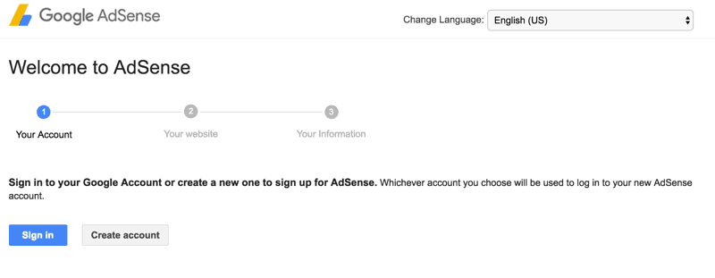
How To Join
1) Go to the Signup page for AdSense .You will see an option to create a new Google account, or you can choose to use your existing Google account
www.dmti.mobi | www.dmti.co.in

Slide 28
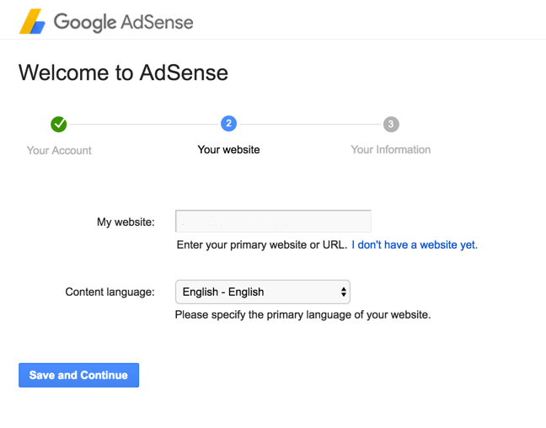
How To Join
2) Enter your website address and select the content language.
www.dmti.mobi | www.dmti.co.in

Slide 29
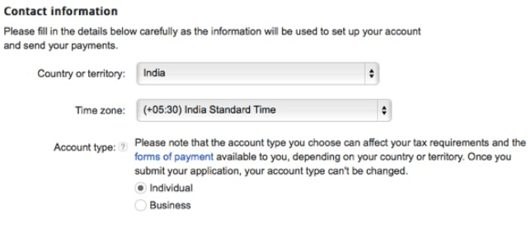
How To Join
3) Submit Your Adsense Application
www.dmti.mobi | www.dmti.co.in

Slide 30
How To Create Ad Units
Login To Your Adsense Dashboard
Click On My Ads
Select Ad Units
Create New Ad Unit
Insert The Code In Your Site Where you want to show ads
www.dmti.mobi | www.dmti.co.in

Slide 31
Key Points
1) Read Adsense program policies Very carefully
2) Understand How to Develop a website that fully compatible for adsense
3 )Selection of Niche (ie, the Selection of subject you are interested to write)
www.dmti.mobi | www.dmti.co.in

Slide 32
Key Points
4) Submit your application to Google with enough content on your site.
5) Avoid articles having attracting titles without having matching content
6) Never try to add keywords intentionally to the article
7) Avoid Copyrighted materials
www.dmti.mobi | www.dmti.co.in

